Slide 1
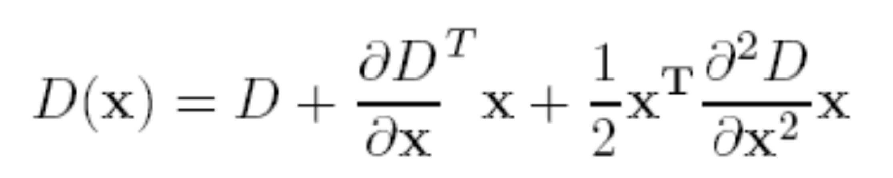
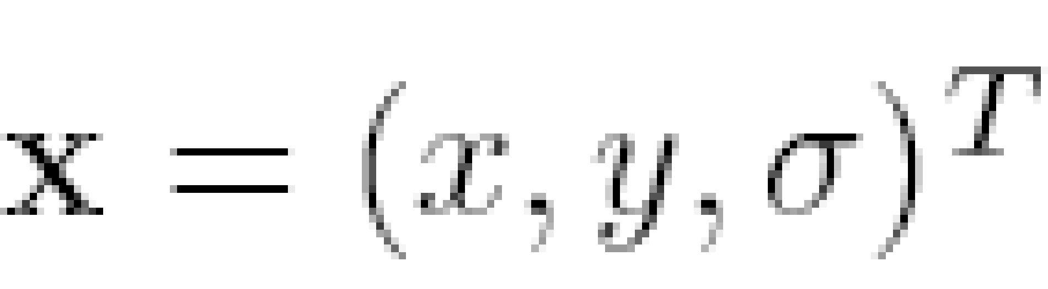
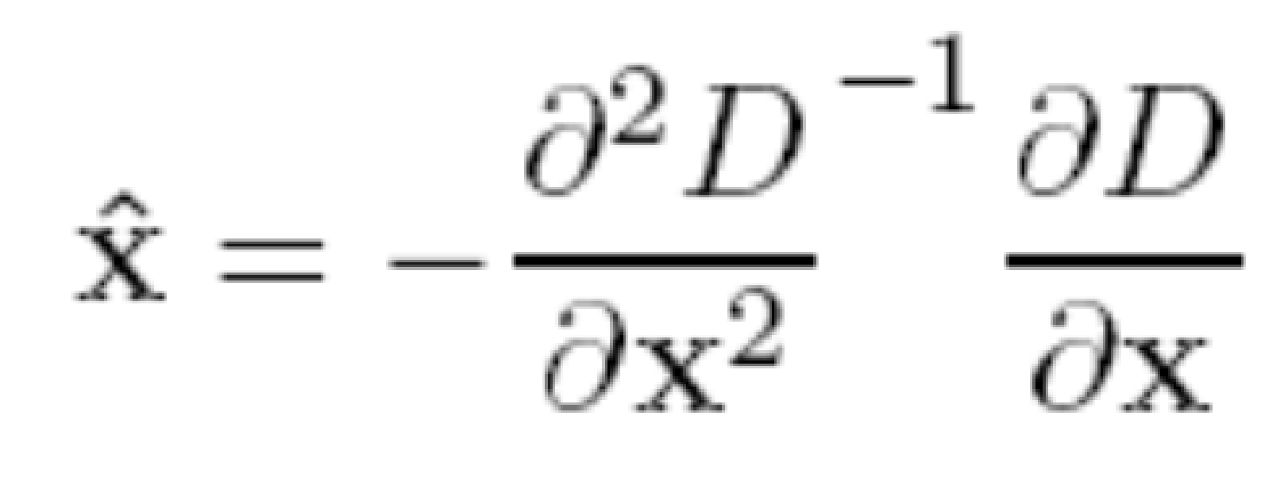
Initial Outlier Rejection (Contrast Thresholding)
Low contrast candidates
Poorly localized candidates along an edge
Taylor series expansion of DOG, D.
Minima or maxima is located at:
Value of D(x) at minima/maxima must be large, |D(x)|>th.

Slide 2
Further Outlier Rejection (Cornerness Thresholding)
DOG has strong response along edge
Assume DOG as a surface
Compute principal curvatures (PC)
Poorly defined peak will have very low curvature along the edge, high across the edge

Slide 3
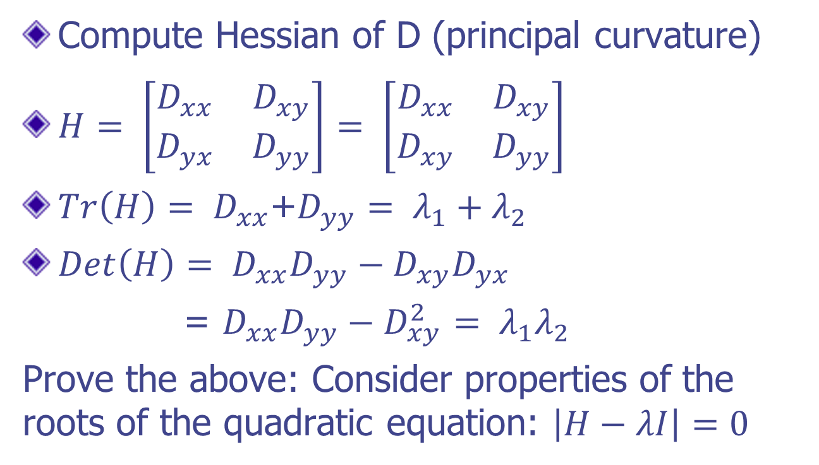
Further Outlier Rejection

Slide 4
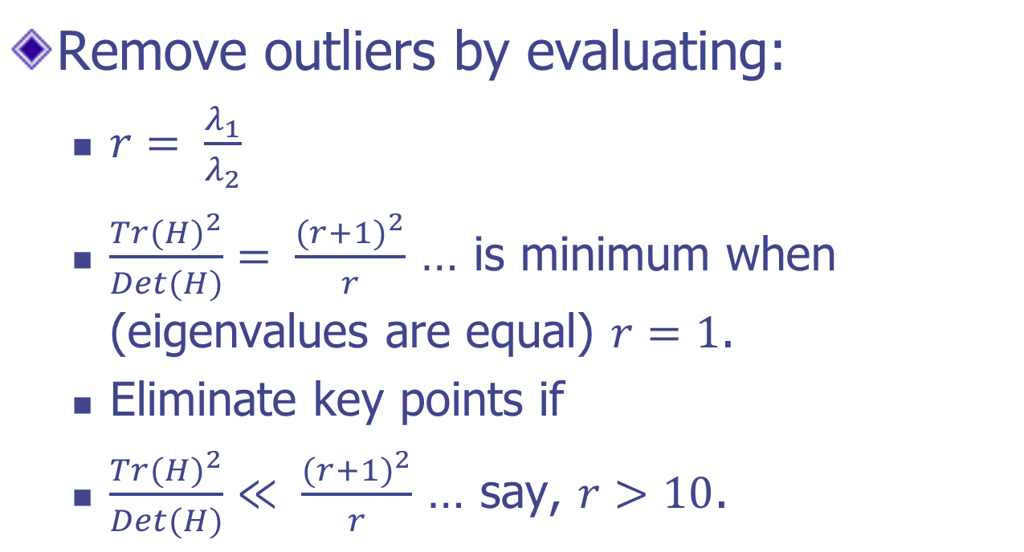
Further Outlier Rejection

Slide 5
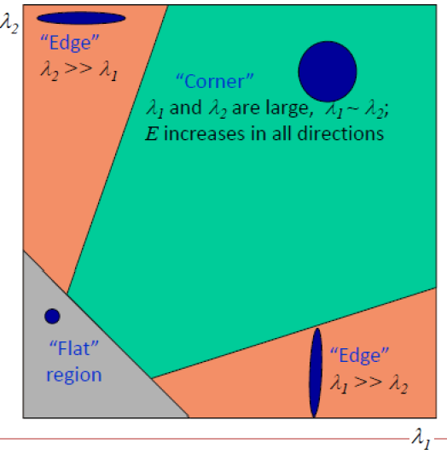
Further Outlier Rejection

Slide 6
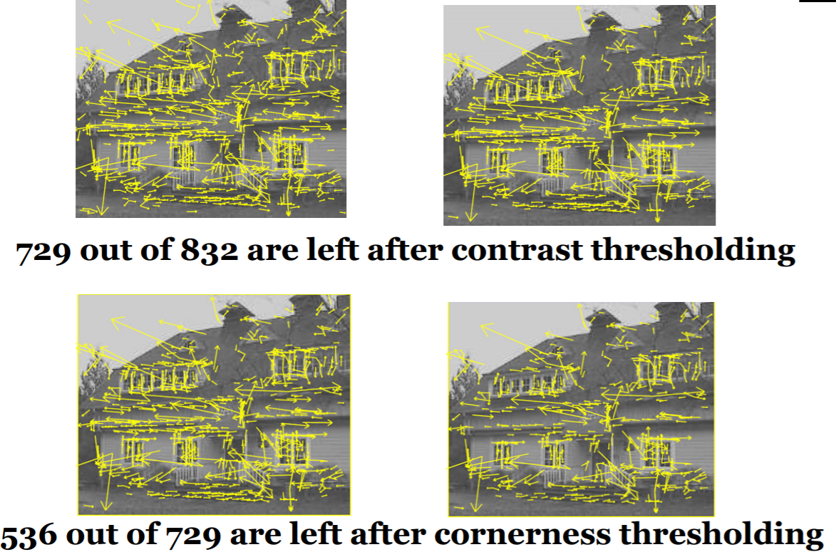
Outlier Rejection
_{th = 0.3}

Slide 7
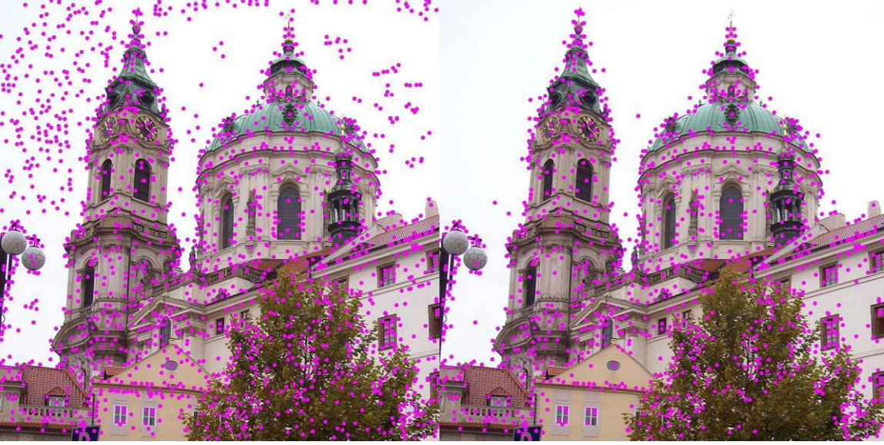
Outlier Rejection
_{th = 0.3}
Removal of low-contrast keypoints

Slide 8
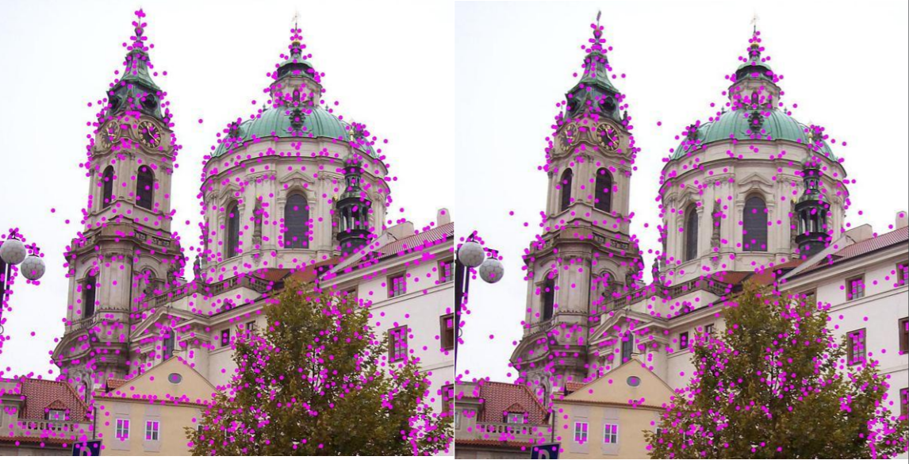
Outlier Rejection
_{th = 0.3}
Removal of high-contrast keypoints residing on edges

Slide 9
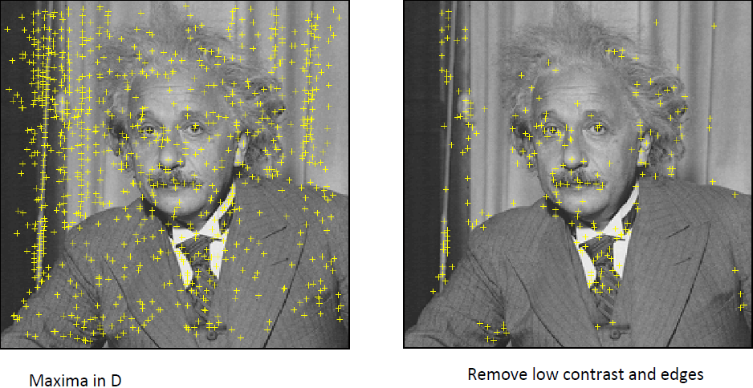
Outlier Rejection

Slide 10
Steps for Extracting Key Points (SIF Points)
Scale space peak selection
Potential locations for finding features
Key point localization
Accurately locating the feature key points
Orientation Assignment
Assigning orientation to the key points
Key point descriptor
Describing the key point as a high dimensional vector (128) (SIFT Descriptor)

Slide 11
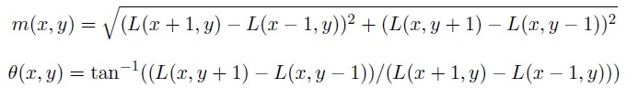
Orientation Assignment
To achieve rotation invariance
Compute central derivatives, gradient magnitude and direction of L (smooth image) at the scale of key point (x,y)
The magnitude and orientation is calculated for all pixels around the keypoint

Slide 12
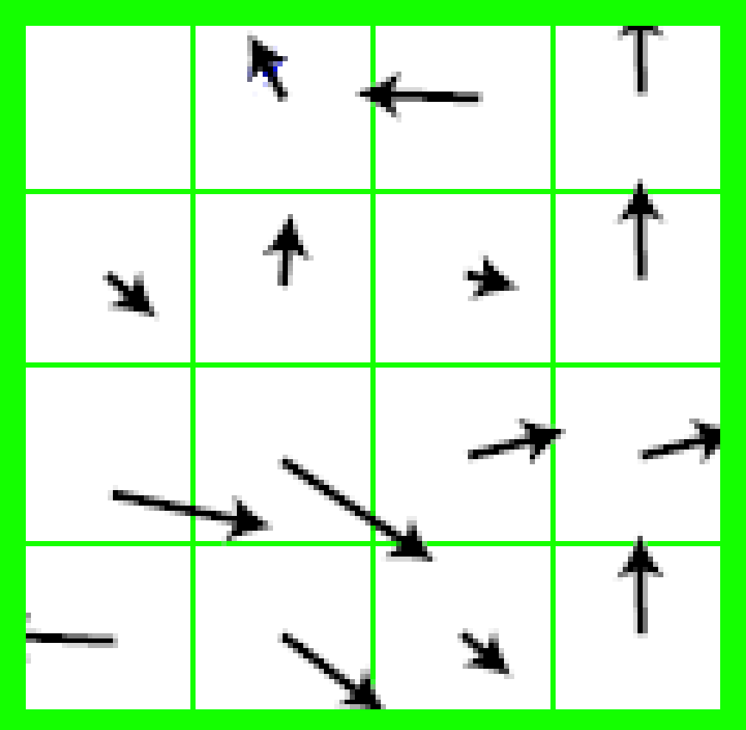
Orientation Assignment
Create a weighted direction histogram in a neighborhood of a key point (36 bins – 10 degrees each)
Weights are
Gradient magnitudes
Spatial Gaussian filter with sigma = =1.5 x <scale of key point>

Slide 13
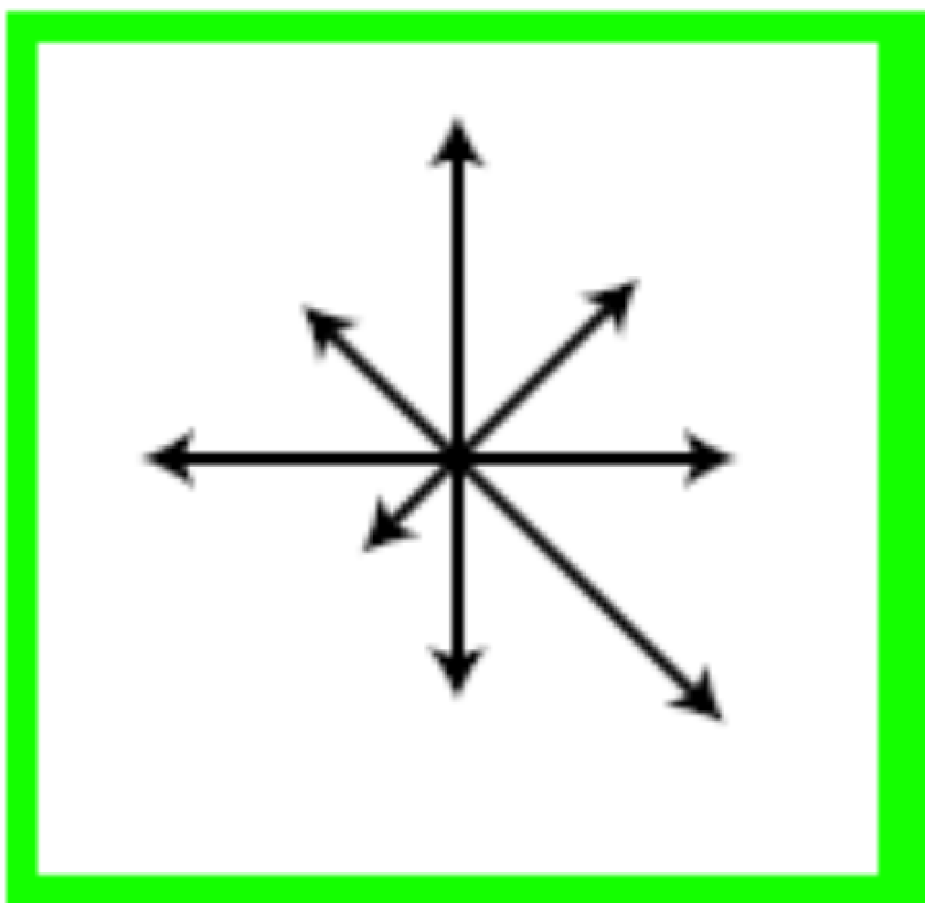
Orientation Assignment
Select the peak as direction of the key point
Introduce additional key points at same location
if another peak is within 80% of max peak of the histogram with different directions

Slide 14
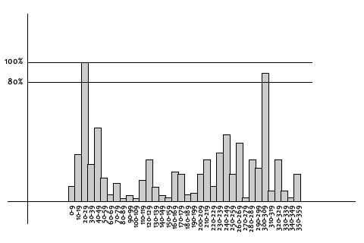
Orientation Assignment: Example
The histogram peaks at 20-29 degrees. So, the keypoint is assigned orientation 3 (the third bin)

Slide 15
Orientation Assignment: Example
Also, peaks above 80% of the highest peak are converted into a new keypoint.
The new keypoint has the same location and scale as the original. But its orientation is equal to the other peak.
So, orientation can split up one keypoint into multiple keypoints.

Slide 16
Steps for Extracting Key Points (SIF Points)
Scale space peak selection
Potential locations for finding features
Key point localization
Accurately locating the feature key points
Orientation Assignment
Assigning orientation to the key points
Key point descriptor
Describing the key point as a high dimensional vector (128) (SIFT Descriptor)

Slide 17
Local Image Descriptors at Key Points
Possible descriptor
Store intensity samples in the neighborhood
Sensitive to lighting changes, 3D object transformation
Use of gradient orientation histograms
Robust representation

Slide 18
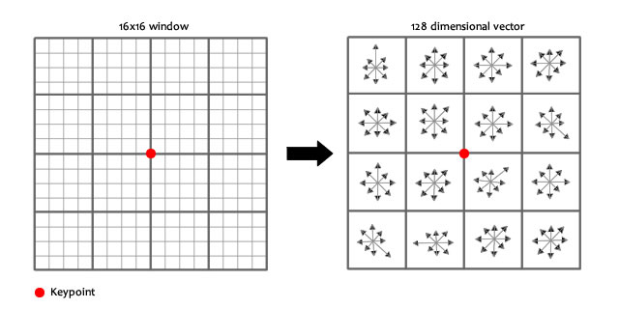
Extraction of Local Image Descriptors at Key Points
Take a 16x16 window around the keypoint
Break this into sixteen 4x4 windows

Slide 19
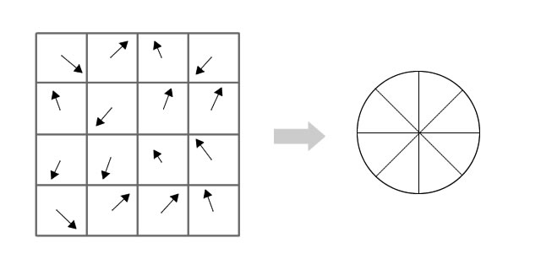
Extraction of Local Image Descriptors at Key Points
Within each 4x4 window, relative (wrt keypoint orientation) gradient magnitudes and orientations are calculated
These orientations are put into an 8 bin histogram

Slide 20
Extraction of Local Image Descriptors at Key Points
Compute relative orientation and magnitude in a 16x16 neighborhood at key point
Form weighted histogram (8 bin) for 4x4 regions
Weight by magnitude and spatial Gaussian
Concatenate 16 histograms in one long vector of 128 dimensions
Feature Vector Formation:
16 totally random orientations are put into 8 predetermined bins.
We do this for all sixteen 4x4 regions.
We have with 4x4x8 = 128 numbers.
Normalize the 128 numbers – divide by root of sum of squares.
These 128 numbers form the "feature vector".
This keypoint is uniquely identified by this feature vector.

Slide 21
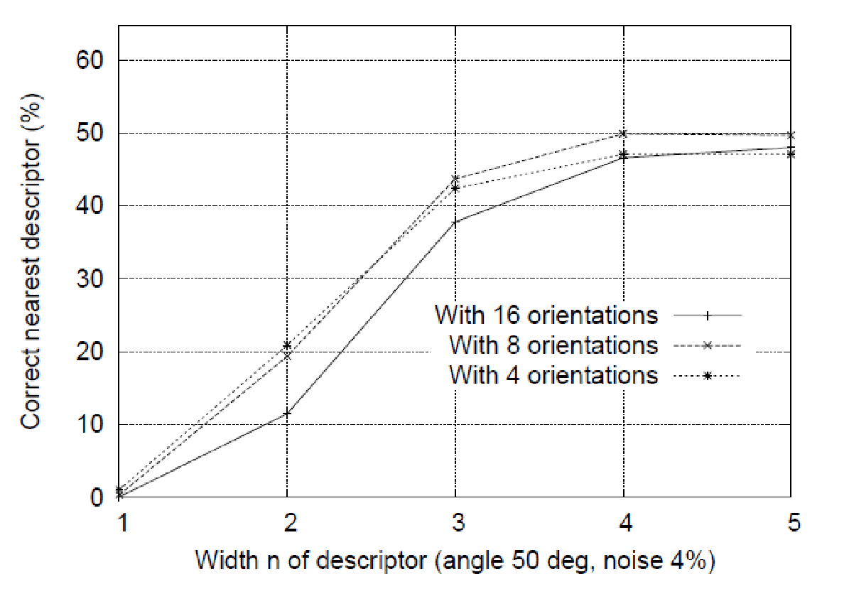
Descriptors Regions (n by n)

Slide 22
Extraction of Local Image Descriptors at Key Points
Store numbers in a vector
Normalize to unit vector (UN)
Illumination invariance (affine changes)
For non-linear intensity transforms
Bound Unit Vector items to maximum 0.2 (truncate gradients larger than 0.2)
Renormalize to unit vector

Slide 23
Key Points Matching
Match the key points against a database obtained from training images
Find the nearest neighbor i.e. a key point with minimum Euclidean distance
Efficient Nearest Neighbor matching
Looks at ratio of distance between best and 2nd best match (.8)

Slide 24
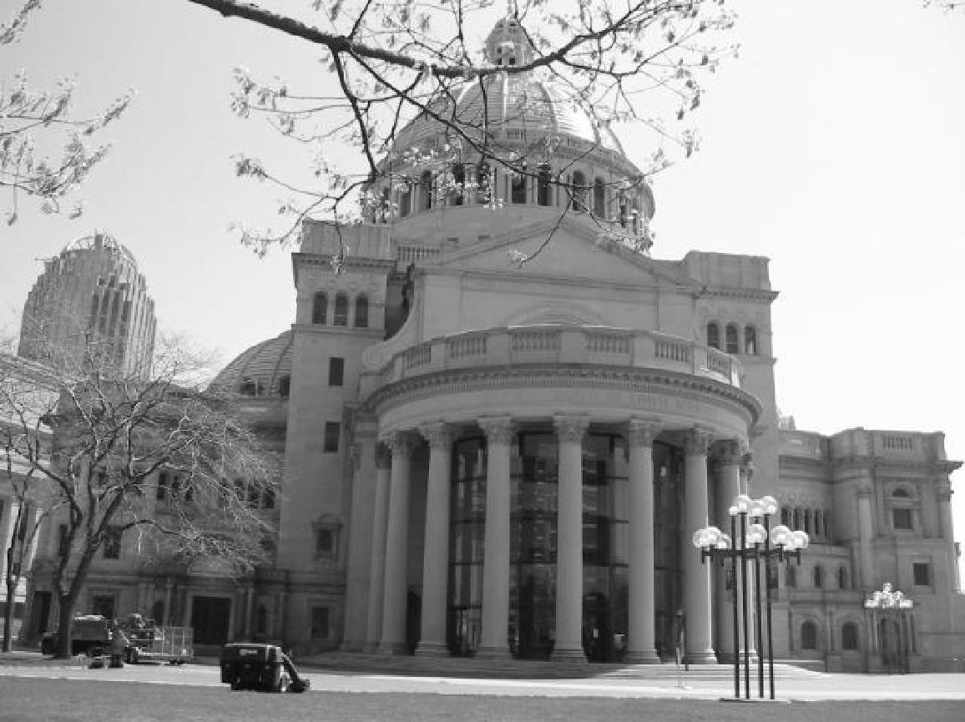
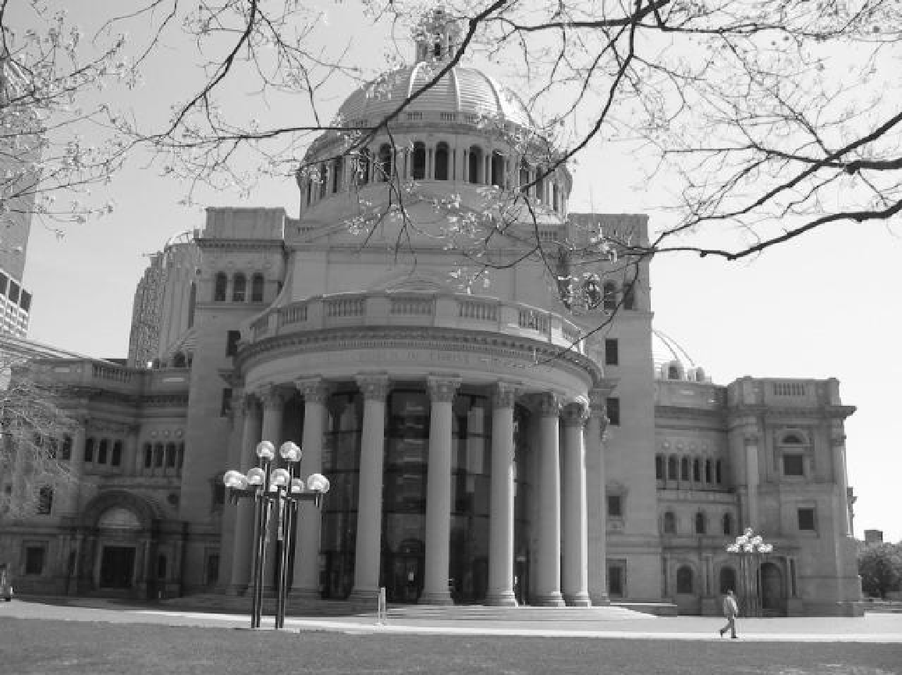
Matching Local Features

Slide 25
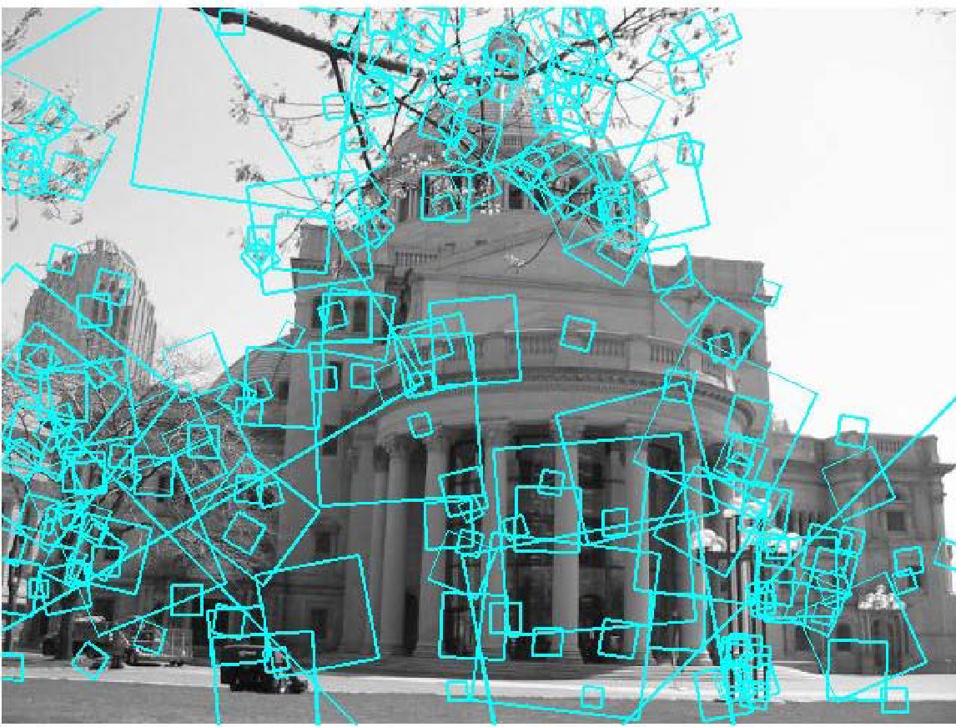
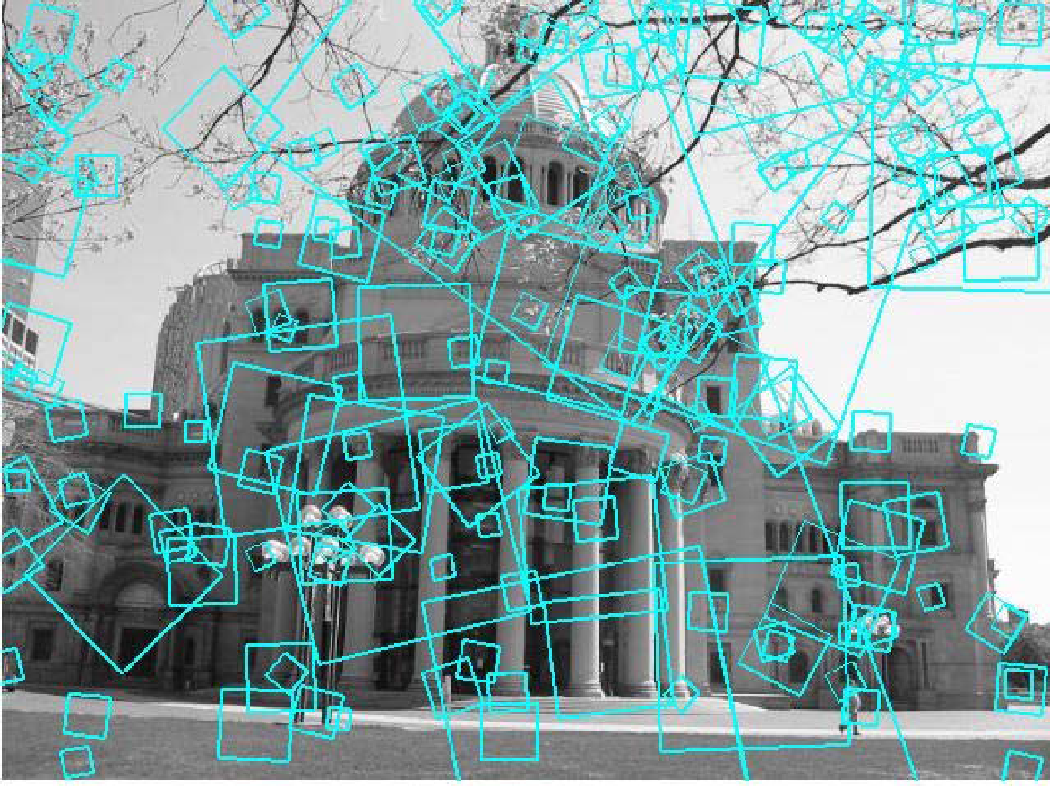
Matching Local Features
?
To generate candidate matches, find patches that have the most similar appearance or SIFT descriptor
Simplest approach: compare them all, take the closest (or closest k, or within a thresholded distance)

Slide 26
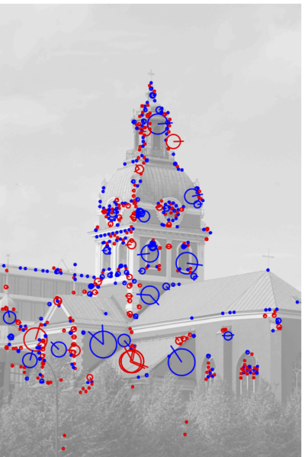
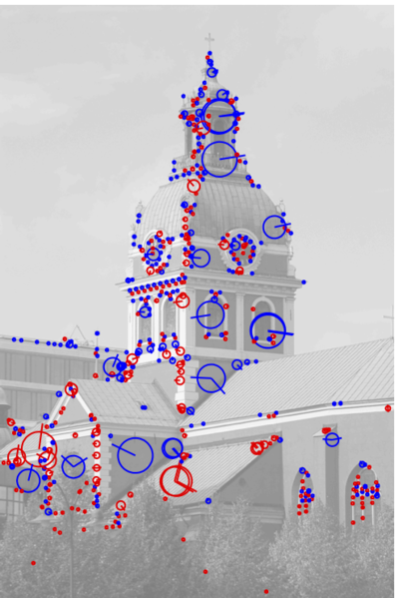
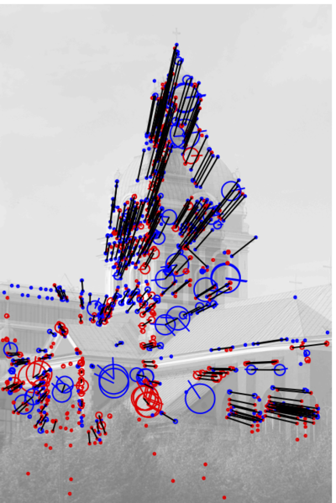
Matching Local Features

Slide 27
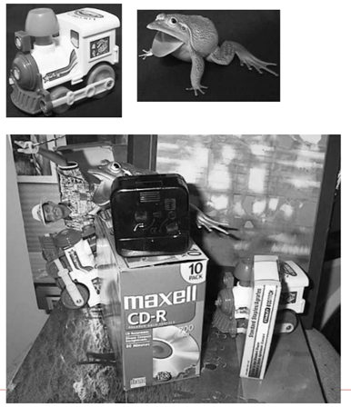
Matching Local Features

Slide 28
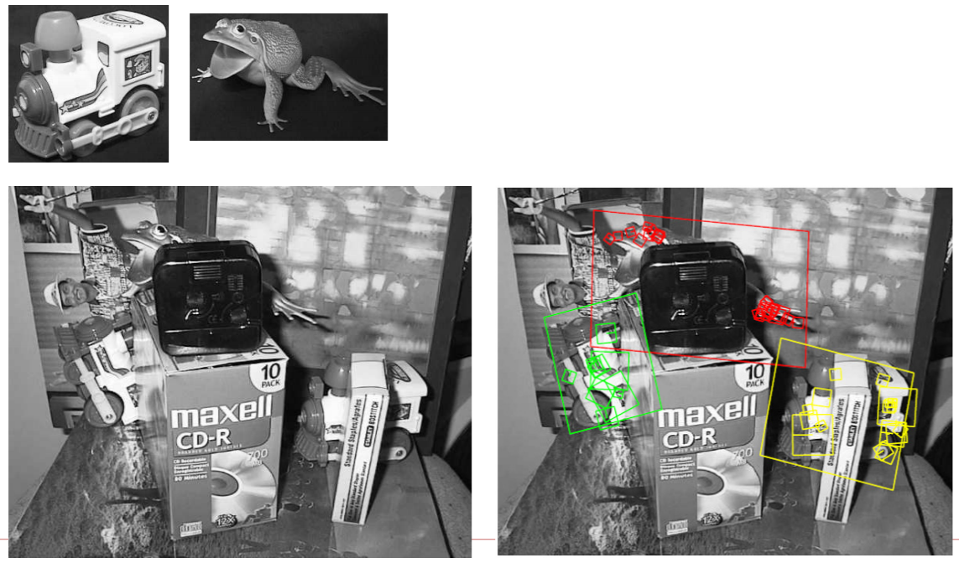
Matching Local Features

Slide 29
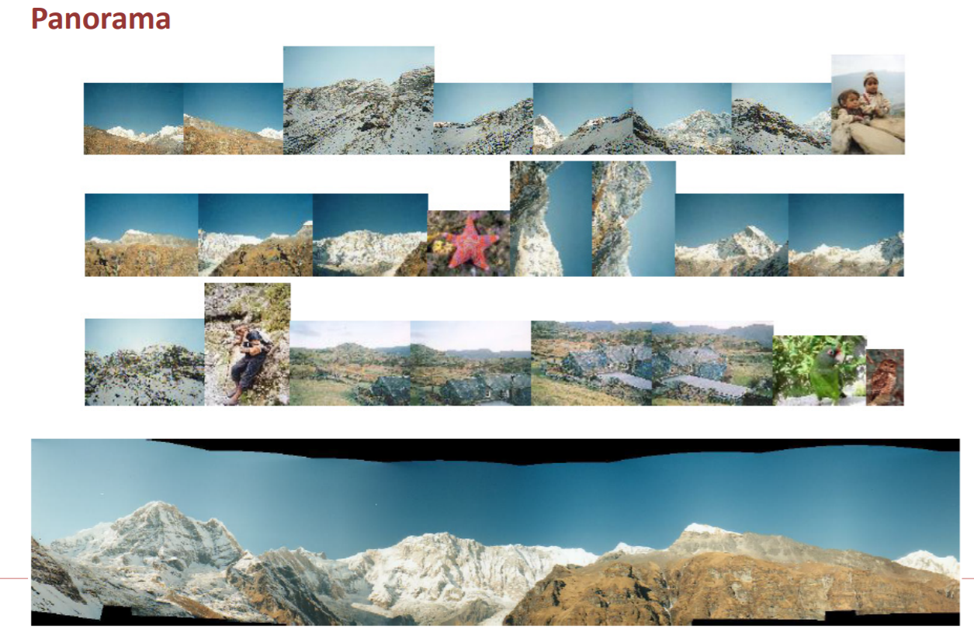
Matching Local Features

Slide 30
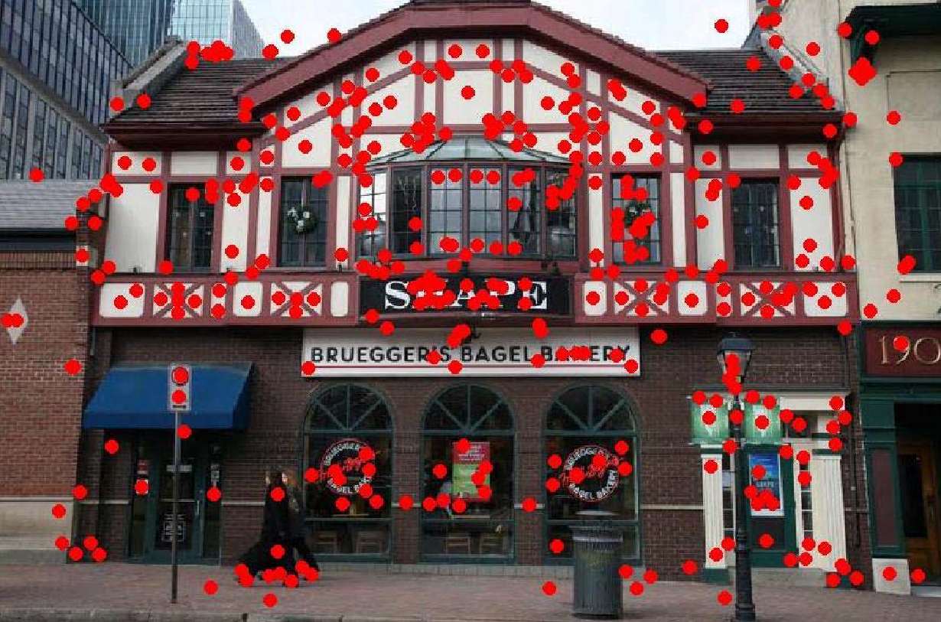
Query Image

Slide 31
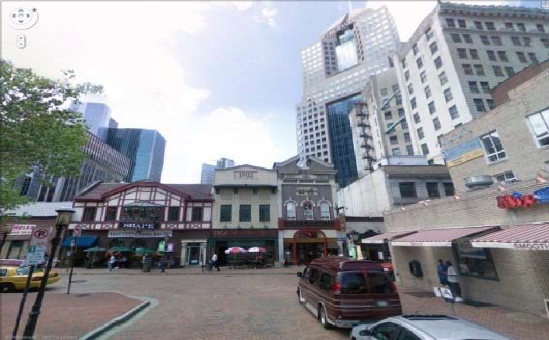
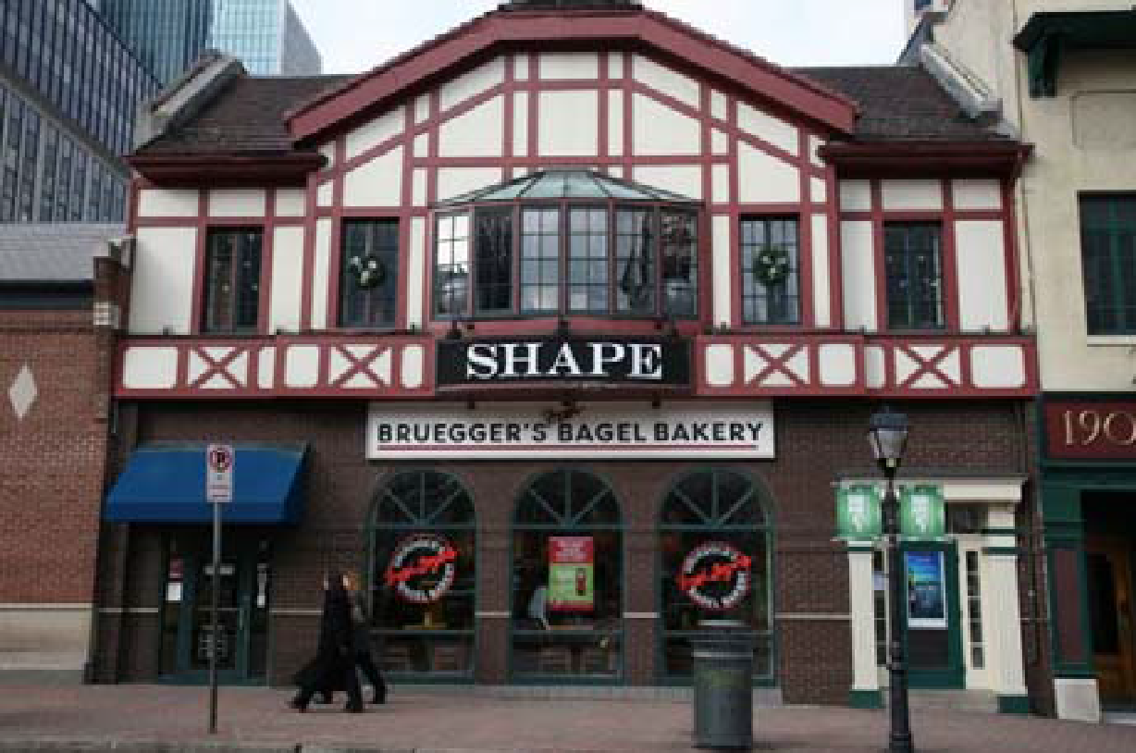
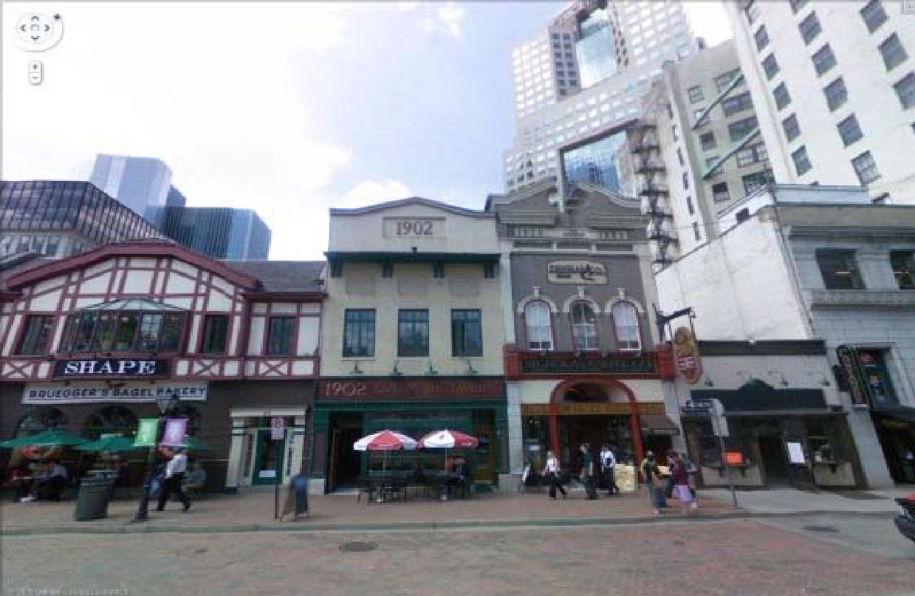
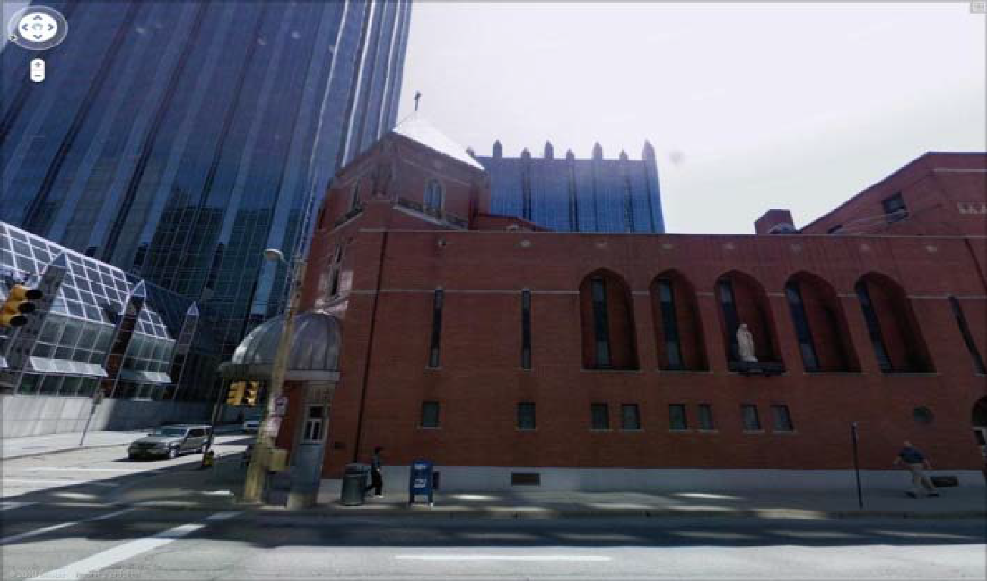
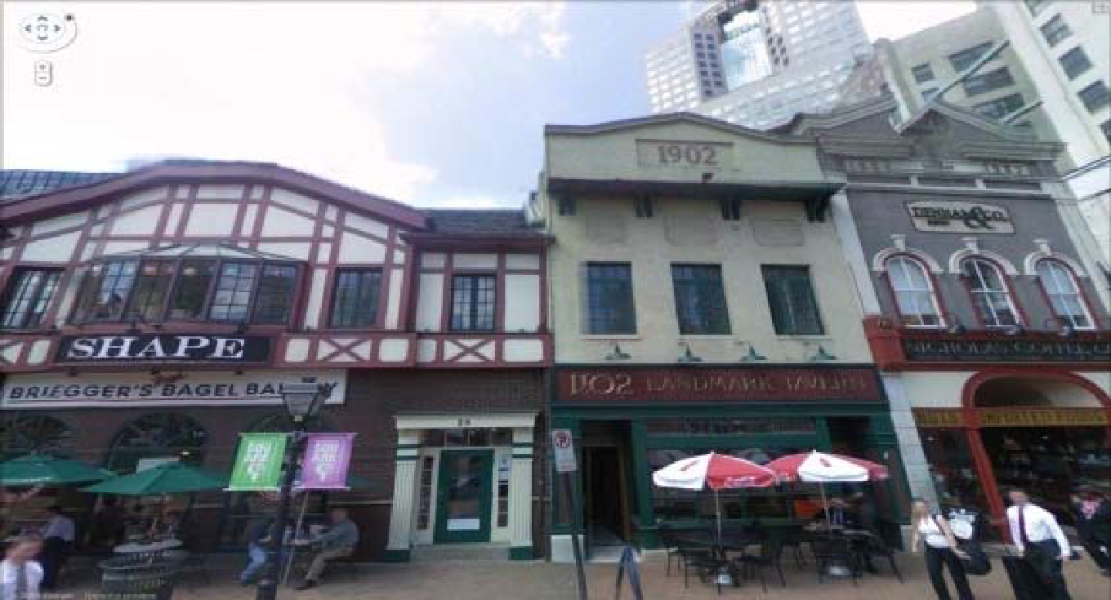
Matched Images

Slide 32
Matching Criteria
If:
Distance to first match : Distance to second match < 0.8,
We have a good match

Slide 33
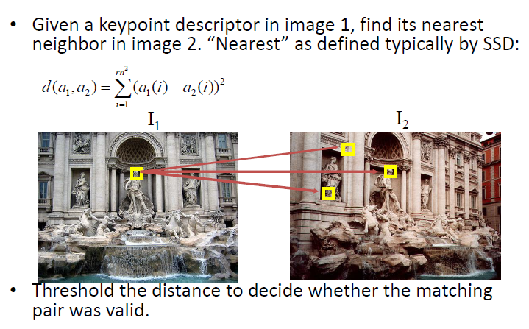
SIFT Example

Slide 34
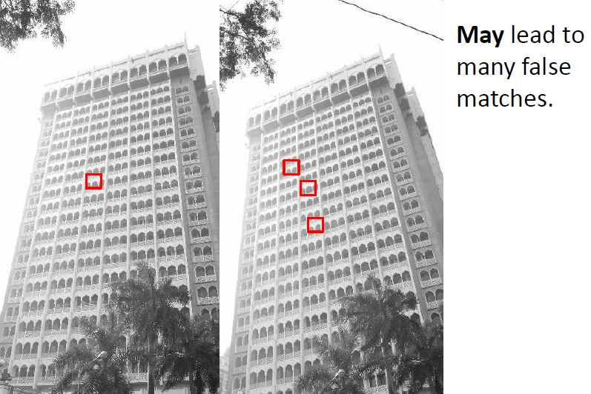
SIFT Example

Slide 35
Ambiguous Matches
?
At what distance do we have a good match?
To add robustness to matching, can consider ratio : distance to best match / distance to second best match
If low, first match looks good.
If high, could be ambiguous match.

Slide 36
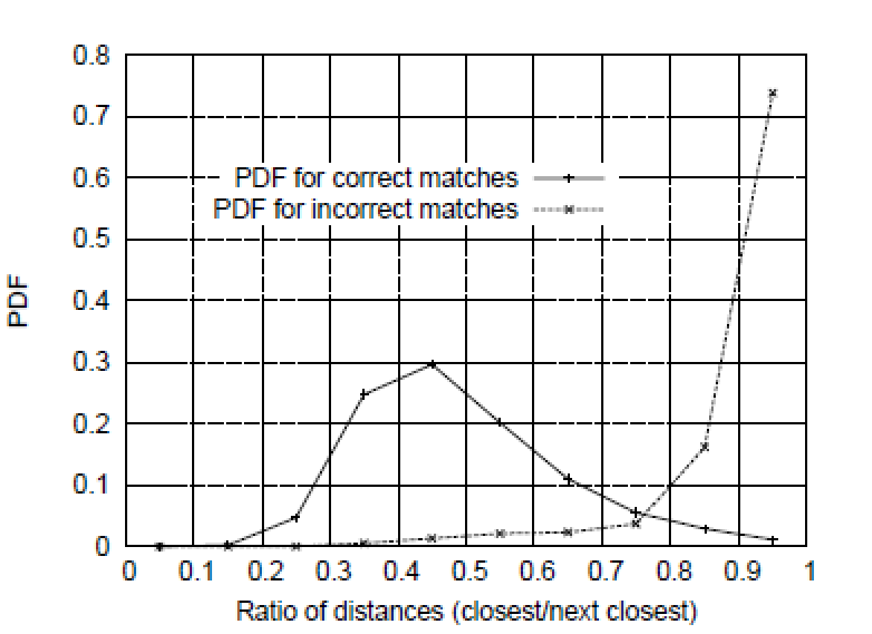
The ratio of distance from the closest to the distance of the second closest

Slide 37
SIFT Detector
Generate Scale Space of an Image
Detect Peaks in Scale Space (extrema)
Localize Interest Points (Taylor Series)
Remove outliers (remove response along edges)
Assign Orientation

Slide 38
SIFT Detector
Compute relative orientation and magnitude in a 16x16 neighborhood at key point
Form weighted histogram (8 bin) for 4x4 regions
Weight by magnitude and spatial Gaussian
Concatenate 16 histograms in one long vector of 128 dimensions
Example for 8x8 to 2x2 descriptors

